Slide 1


Slide 2


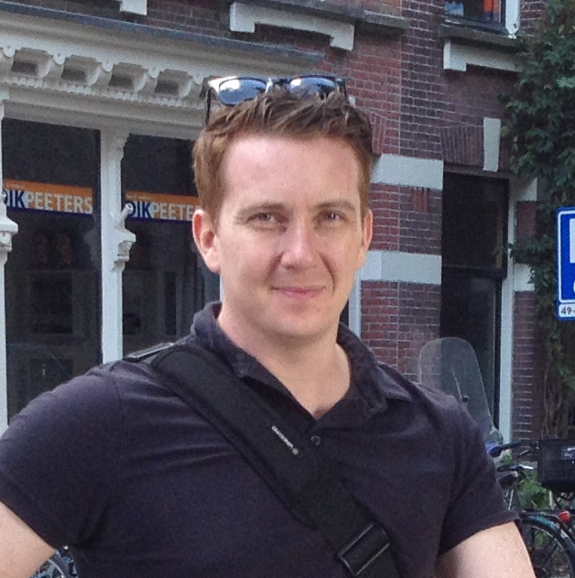
Developing the standard language for MaaS:
a perspective from MaaS provider, government and transport operator
MaaS Congres 2020
Pim van der Toolen Bon Bakermans Ross Curzon-Butler

Slide 3


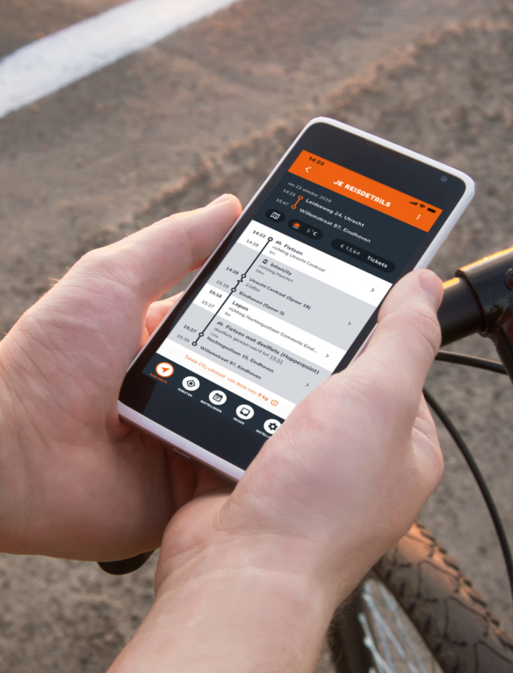

Introductions

Slide 4
1. The what and why of the TOMP-API
2. TOMP, the enabler of MaaS
3. An international perspective
4. Future steps and development

Slide 5
1. The what and why of the TOMP-API
2. TOMP, the enabler of MaaS
3. An international perspective
4. Future steps and development

Slide 6
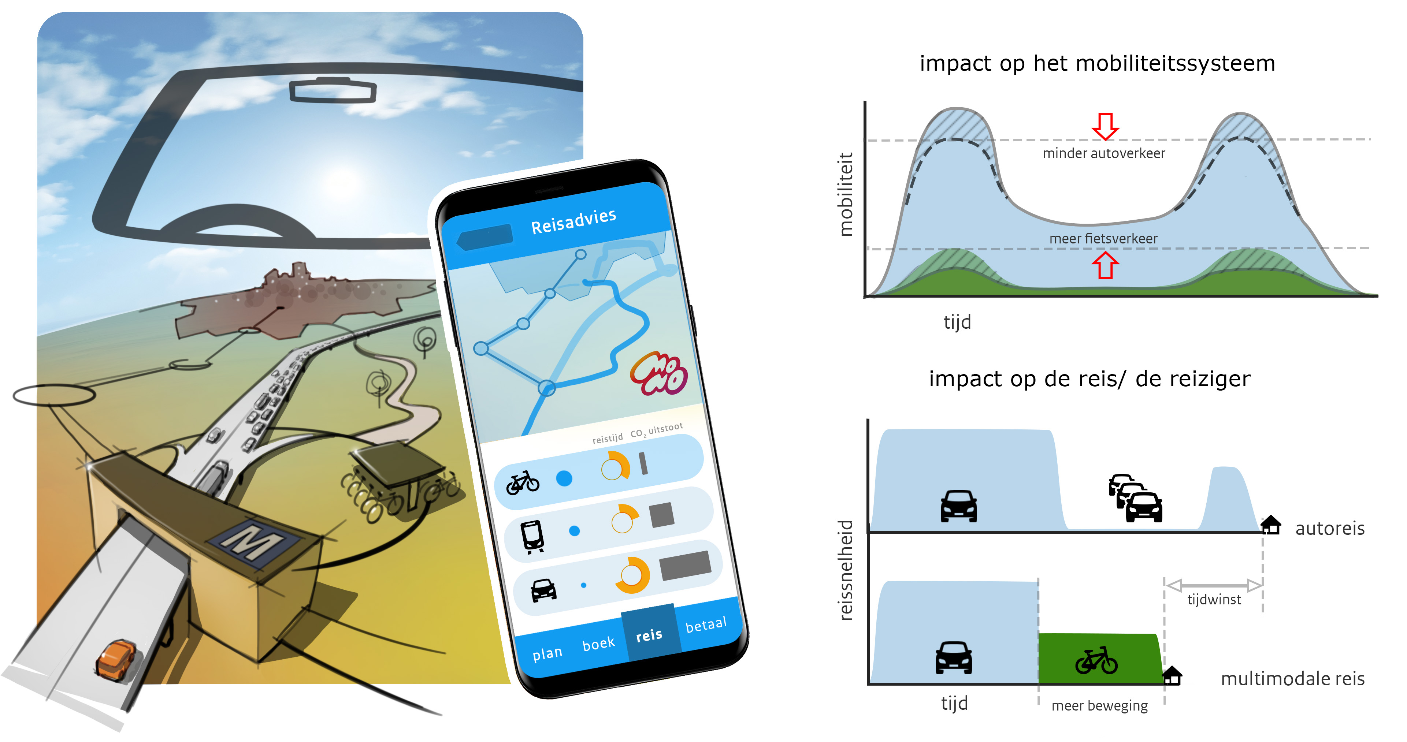
MaaS: Optimizing the mobility system?

Slide 7
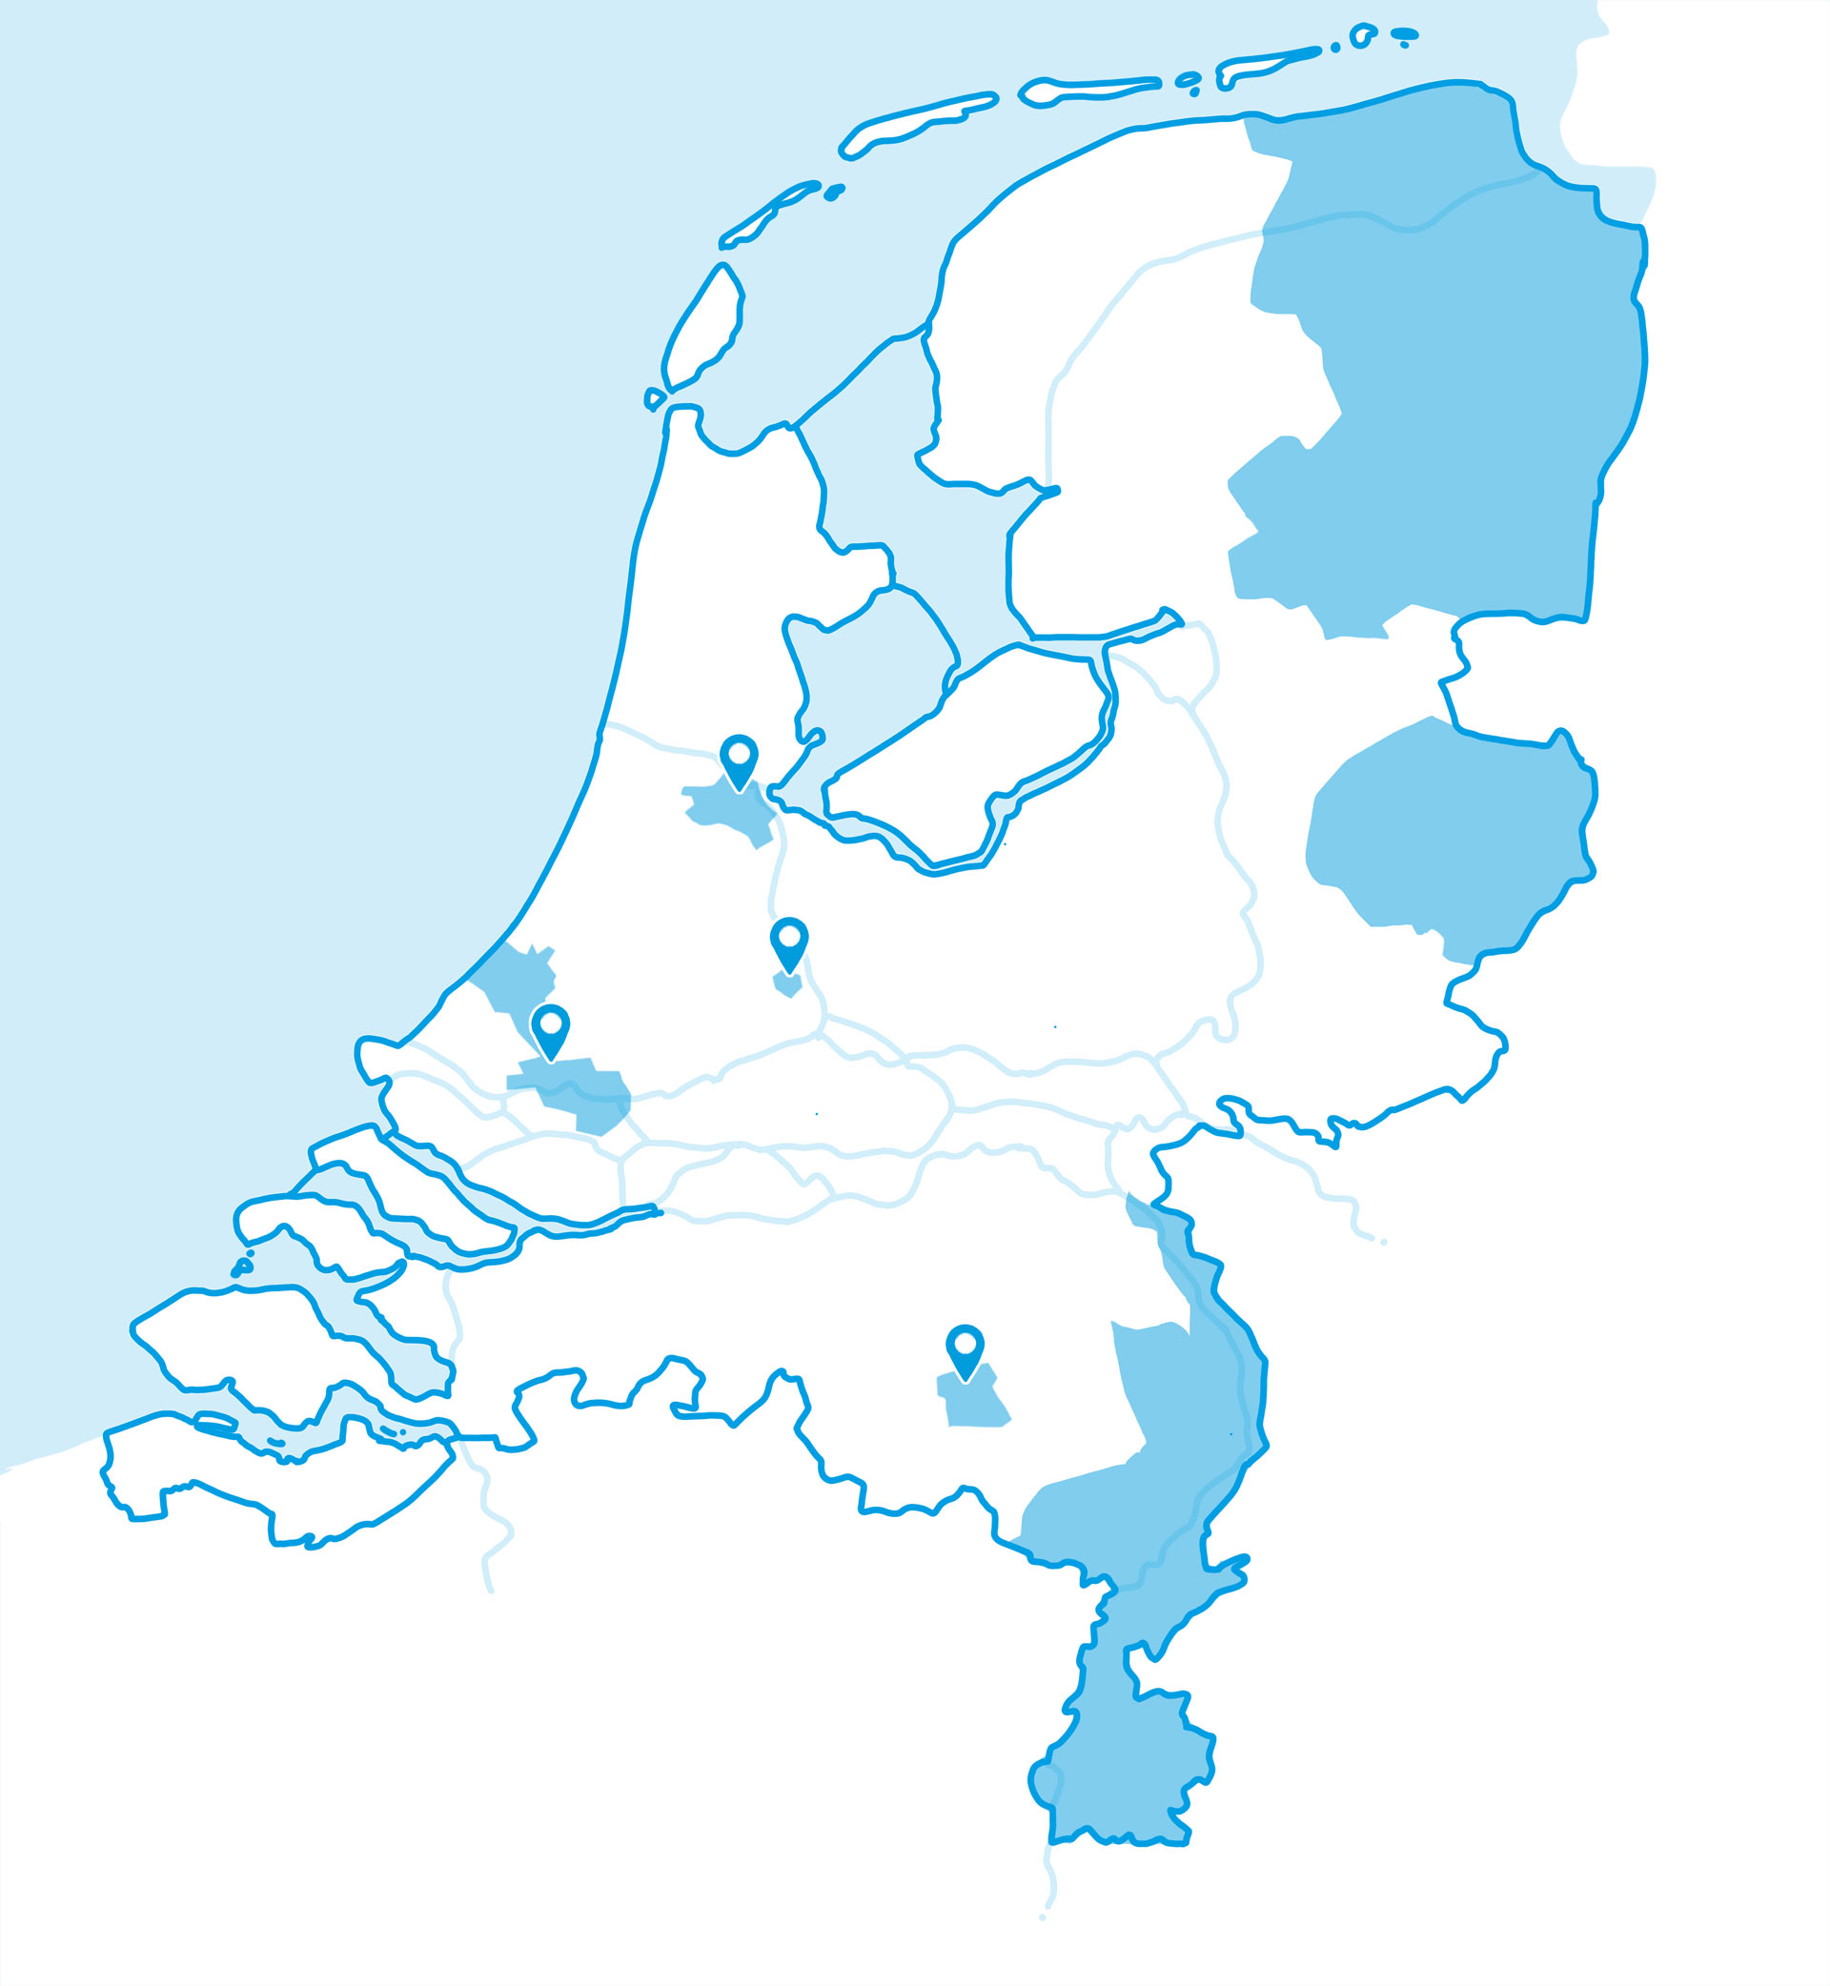
7 Landelijk opschaalbare regiopilots
7 National pilots
Limburg
Achieving sustainable mobility by offering multimodal, cross-border and door-to-door transport solutions.
Groningen-Drenthe
Improving mobility towards the Drenthe and Groningen countryside and the affordability of the transport system, including by combining target group transportation and regular public transport.
Utrecht Leidsche Rijn
Tempting Leidsche Rijn residents to use alternative transport options in order to reduce traffic and congestion volumes in the area.
Twente
Introducing better and cheaper target group transportation and small-scale public transport by cleverly combining traffic flows.
Amsterdam
Improving mobility towards the Zuidas and making better use of the public urban space by offering alternative transport options.
Rotterdam-The Hague & Airport
Improving the land-side accessibility of Rotterdam The Hague Airport for travellers and employees by improving access to the airport in a sustainable and multimodal way using door-to-door solutions.
Eindhoven
Sustainable and emission-free mobility for employees of the municipality of Eindhoven. The city of Eindhoven wants to become a carbon-neutral city.

Slide 8
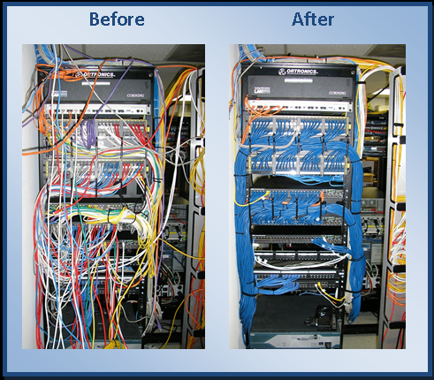
Our aim: standard language between TO and MP

Slide 9







MaaS provider
Transport Operator
Gate
way
Gate
way
Assets
Backoffice
Backoffice

Slide 10





MaaS provider
Transport Operator
Gate
way
Multi modal trip planner
Adapter

Slide 11
Transport Operator
MaaS Provider
Gate
way
MP 1
MP 2
MP 3
Adapter
Our Own Users

Slide 12
1. The what and why of the TOMP-API
2. TOMP, the enabler of MaaS
3. An international perspective
4. Future steps and development

Slide 13
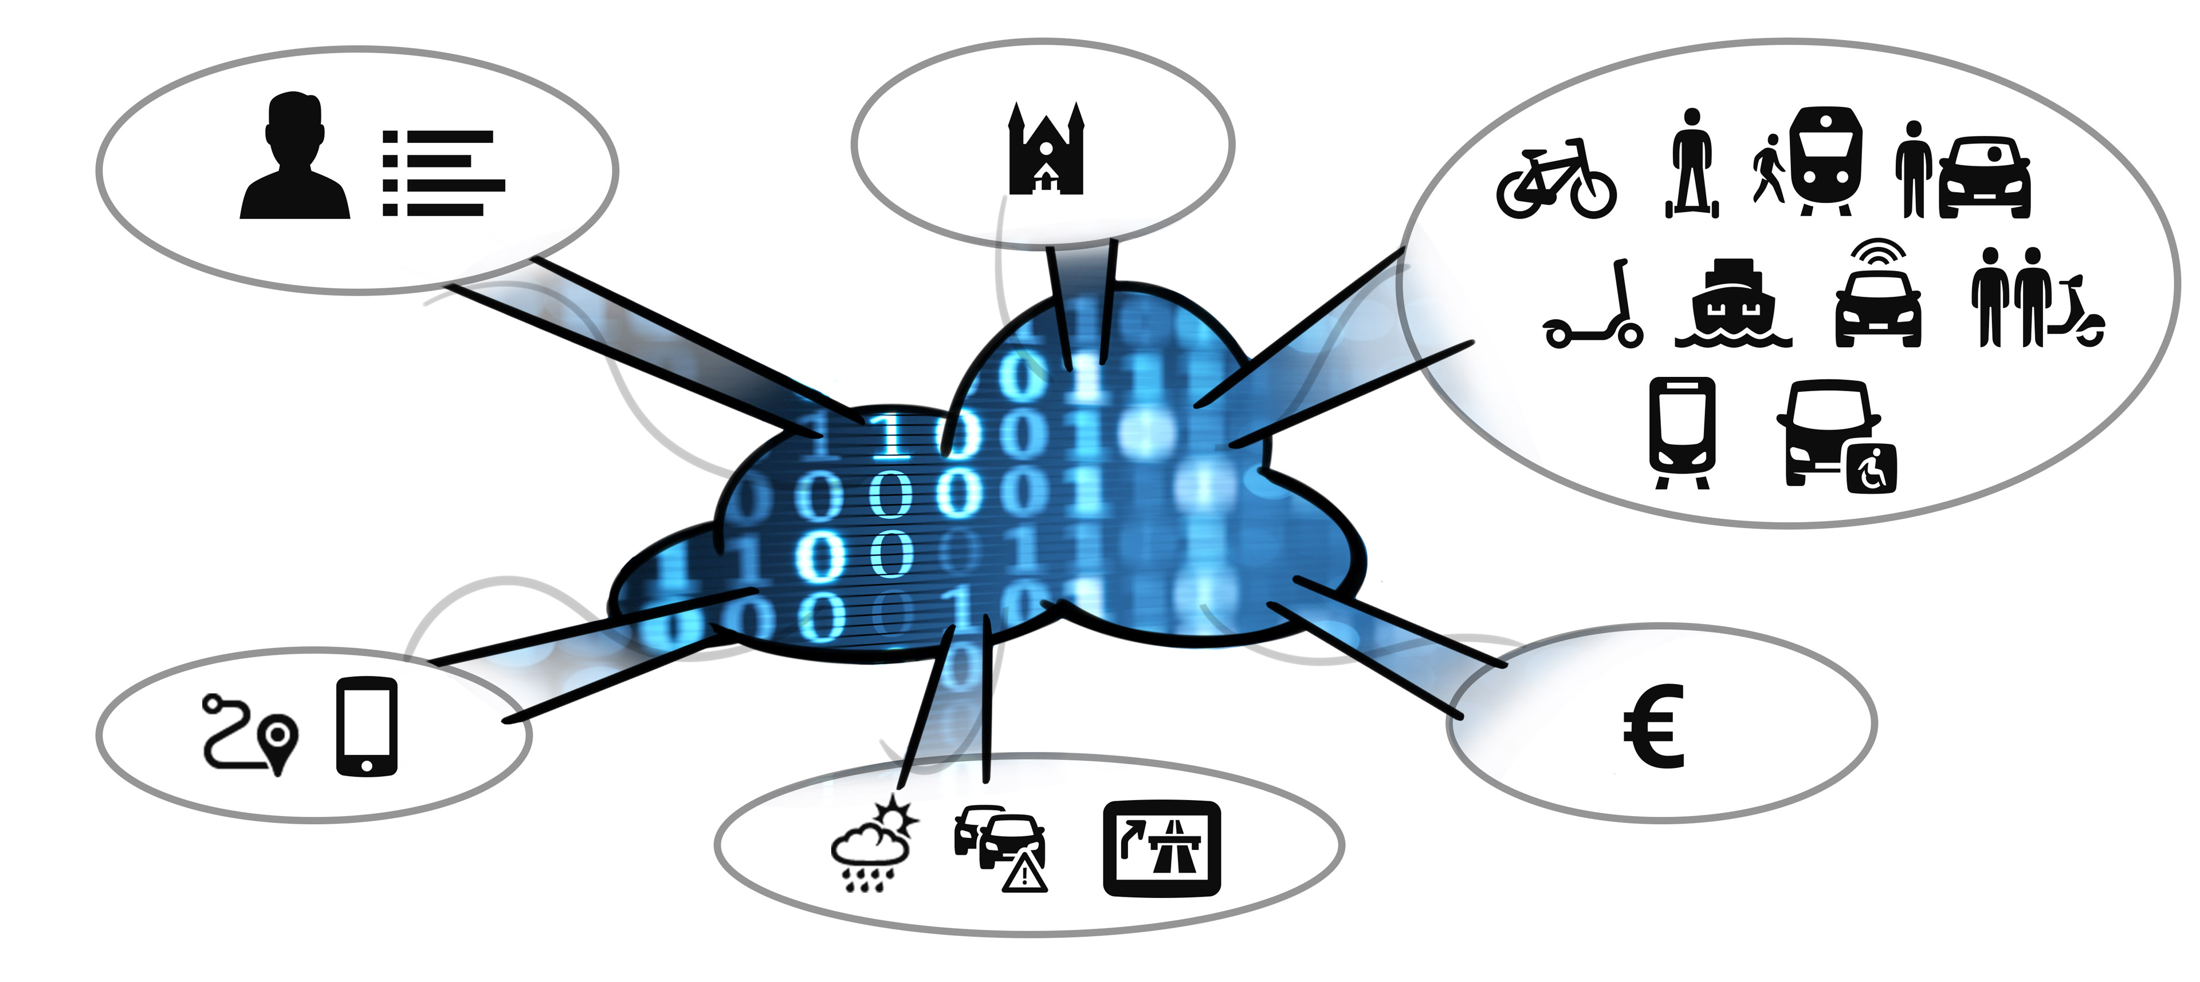
Standardization results in (efficient) ecosystem
End user
Government
Transport operators
MaaS service providers
Transaction processors
Common data providers

Slide 14
Architecture
Users
MaaS Provider
Standardising the interface between MaaS-providers and Transport Operators, taking the whole chain into account
API
API
API
API
Transport
operators
Transport
operators
Transport
operators
Transport
operators

Slide 15

Following TOMP
Release TOMP 1.1
Release TOMP 1.2
Release TOMP 2.0
Implementation 1.1
Implementation 1.2
Implementation 1.1
Implementation 1.2
Implementation 2.0
Implementation 2.0

Slide 16
1. The what and why of the TOMP-API
2. TOMP, the enabler of MaaS
3. An international perspective
4. Future steps and development

Slide 17

International adoption of the blueprint

Slide 18










International adoption of the blueprint

Slide 19
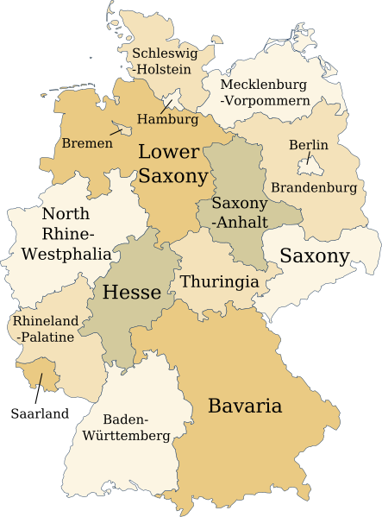
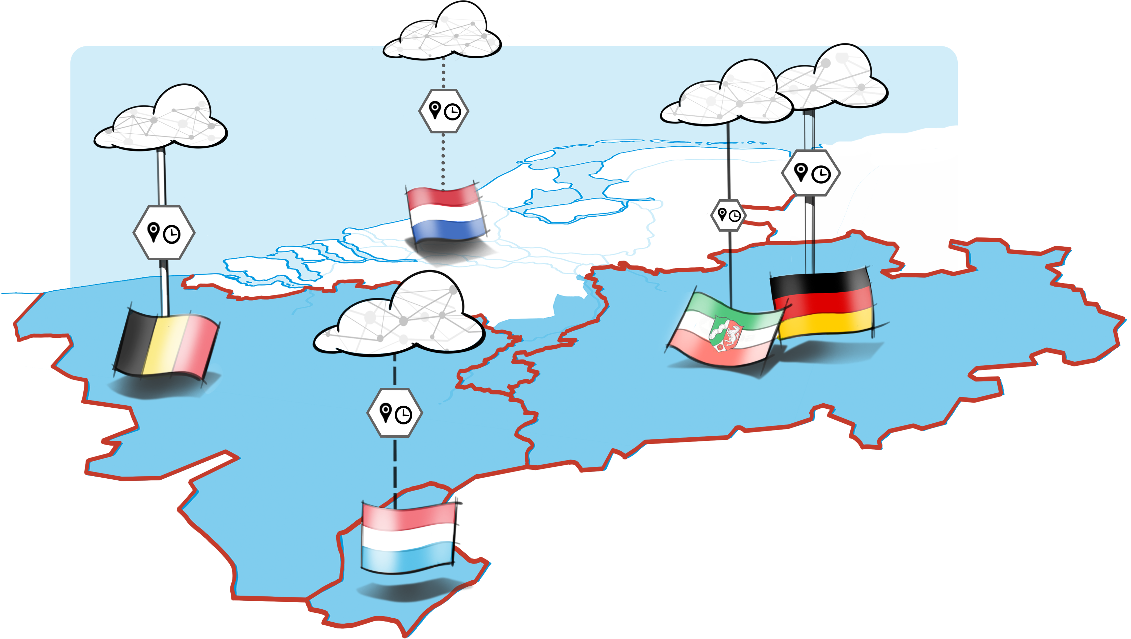
Case: crossborder pilot in Limburg

Slide 20
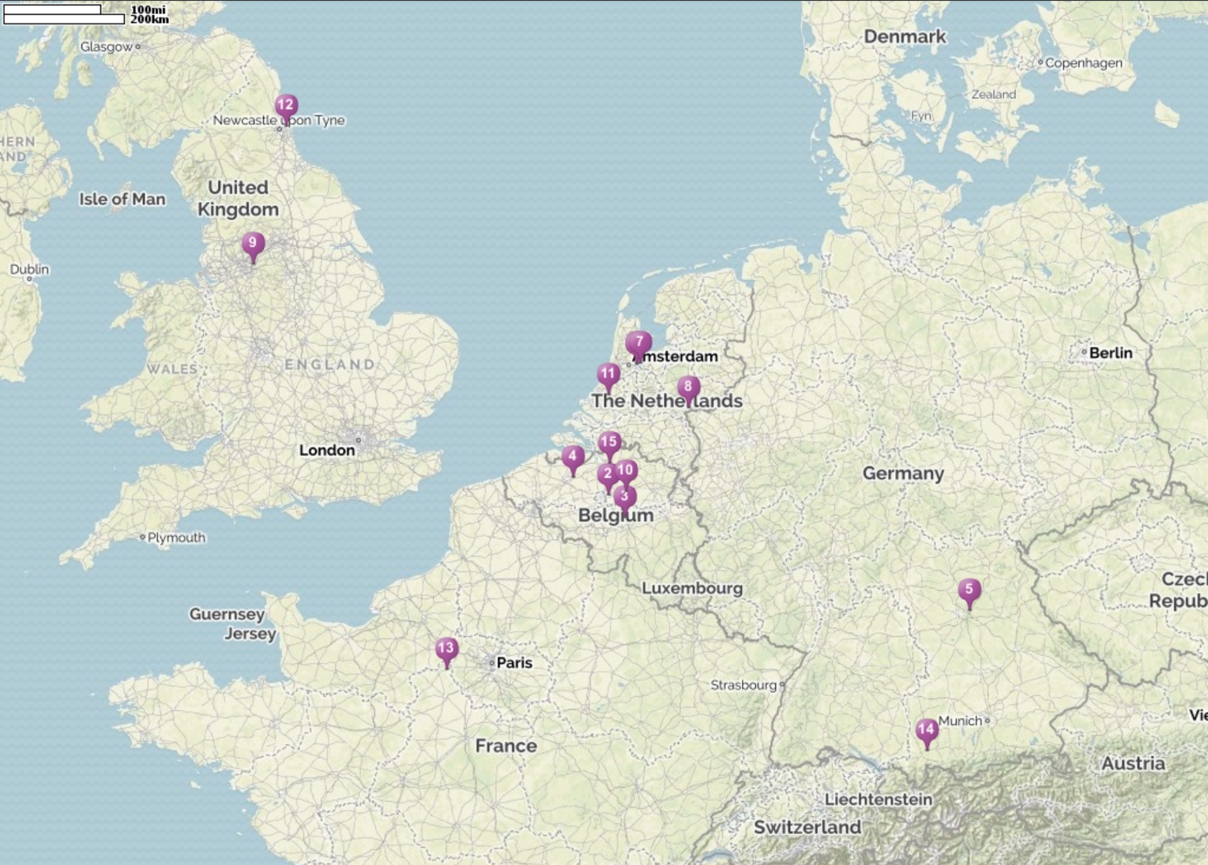

We’re also taking it across Europe and the UK

Slide 21
1. The what and why of the TOMP-API
2. TOMP, the enabler of MaaS
3. An international perspective
4. Future steps and development

Slide 22
TO-MP API Working Group Roadmap
Last update: 10/01/2020
v1.1
v1.2
v1.3
v1.4
v2.0
Core Modules
Planning
Payment
Planning
User Privacy & Authentication
Booking
Basic Functionality
Booking
Define scenarios and scope for v1.2 or for dedicated payment API
Trip Ex.
Enhanced Functionality
Trip Ex.
Support
Payment
A&O info
A&O info
Support
Implementation & Validation
API testing environment
Validation by TOs & MPs
Implementation in MaaS pilots (NL & others)
Update testing environment
Collect feedback from MaaS pilots
Licensing and Certification
API License
Document License
Define certification programme
Certify first TOs and MPs
Documentation
Blueprint v1.1
Define Maintenance & Support programme
Blueprint update
Wiki update
Wiki
Other developments
Dedicated payment API (?)
Data Sharing API v. 0.1
Define data sharing API scope
↓ Other (Non-Technical) aspects ↓
TO-MP API WG governance
Lead & Mgmt by Ministry I&WM
Rotating chair
Management by Project Leadership & Technical Steering committees
Statutes review & members’ evaluation
Roles and Responsibilities
Statutes
Dissemination and networking
MaaS Alliance standards WG
Homepage
MaaS Congress
KNV MaaS-Lab
SEP
OCT
NOV
DEC
JAN
FEB
MAR
APR
MAY
JUN
JUL
AUG
SEP
OCT
NOV
DEC
JAN
FEB
MAR
APR
MAY
JUN
2019
2020
2021

Slide 23
Learning by doing
TOMP release
Implement
Experience
TOMP working group
Adaptation of TOMP

Slide 24
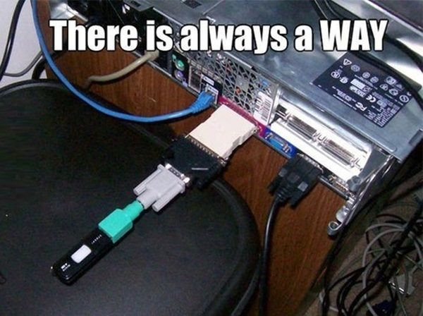
MaaS provider
Interpretation 3
Adapter 1
Interpretation 2
Transport operator

Slide 25
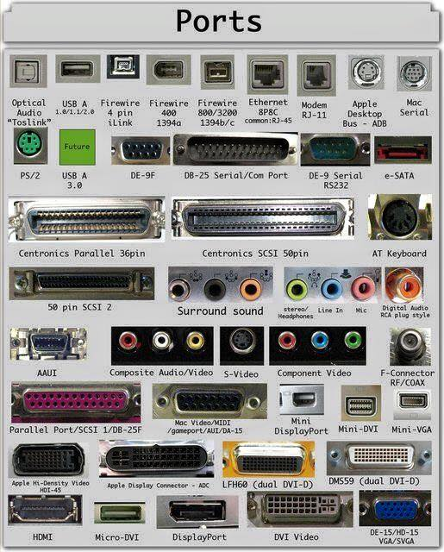



Slide 27

github.com/TOMP-WG

Slide 28
Developing the standard language for MaaS:
a perspective from MaaS provider, government and transport operator
MaaS Congres 2020
Pim van der Toolen Bon Bakermans Ross Curzon-Butler

